Slide 1
Measurement| Documents and Archives
Doing Political Research, Week 7

Slide 2
Research Design: Key Points
Outline a plan for a research project that would answer an original research question of your own choosing
2500 words (+/- 10%), including footnotes and bibliography
Any referencing style, as long as it is consistent
Deadline: noon on 8th January
Week 10 class: discuss your ideas

Slide 3

Research Design: Questions to Think About
What is your research question?
Where does your proposed research fit into existing literature on the topic? How will you build on existing studies?
What is your theory? Will you be testing an existing theory, developing a new theory or adapting an existing theory to a different context?
What are the key concepts in your research project? How will you operationalise and measure them?
Which method(s) will you use to answer your question? Why use this method, or set of methods?
How will you collect your data? How will you analyse the data you collect?
What practical difficulties might you face when collecting and analysing your data? How will you overcome them?
What ethical issues might arise during your research project? How will you ensure that your research meets relevant ethical standards?

Slide 4
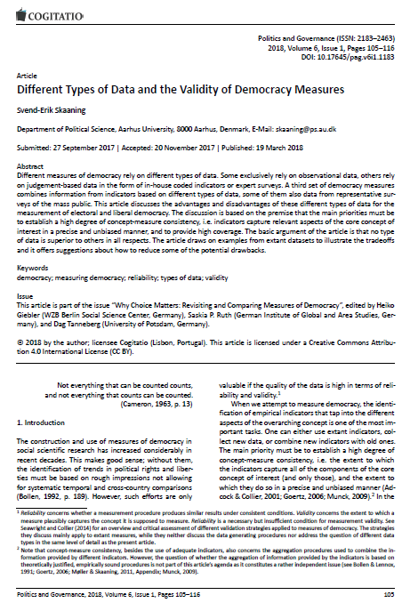
Skaaning
What types of data on democracy does Skaaning discuss? Which types are more or less useful?
How could we go about combining different types of data into a single measure? Would this be worthwhile? What would the challenges be?
Are there any other types of data we could use to measure democracy?

Slide 5
Measurement
Design a measure to operationalise the intensity of civil wars.
What will your coding scheme be?
What evidence will you use to code individual cases?

Slide 6
Designing an Archive/Document-based Research Project
Choose a research question to investigate a political process or phenomenon and design an archive- or document-based study to research it.
What materials do you need to get access to? Where are these materials? How can you get access to them?
What materials exist, and how might the different kinds of bias affect what is available?
How will you analyse the contents of the documents?

Slide 7
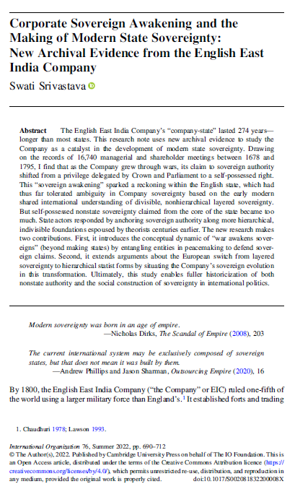
Srivastava
What archives and documents did Srivastava use?
How did she analyse these sources?
What other sources could she have looked at?
How could the study have been improved? What other methods could have been used?

